Slide 1
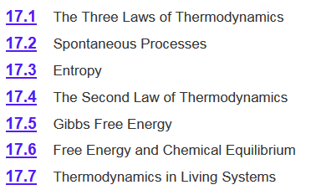
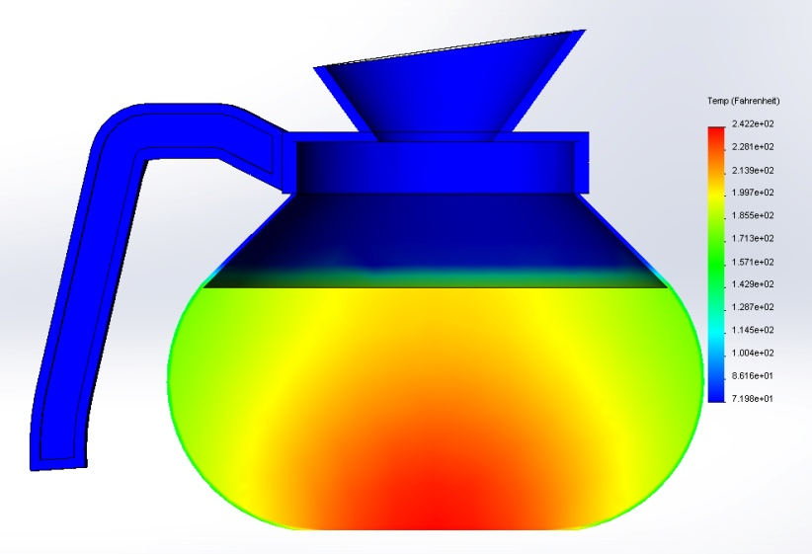
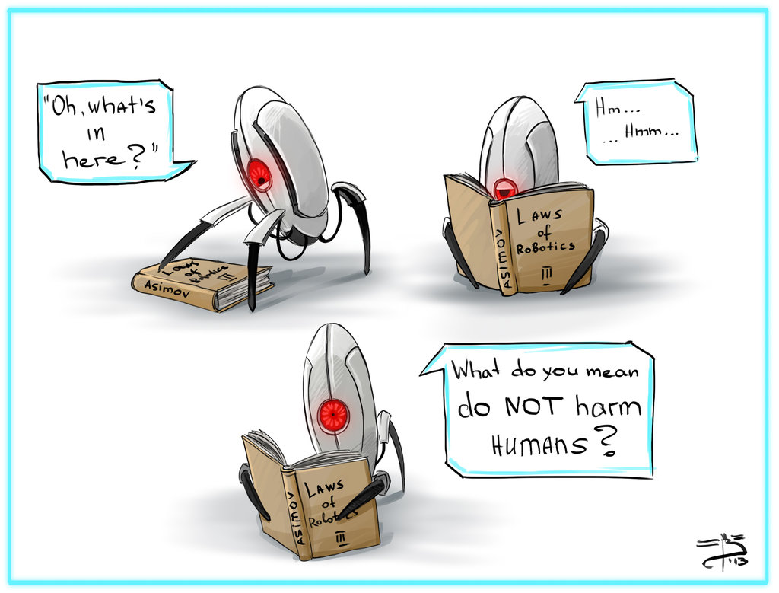
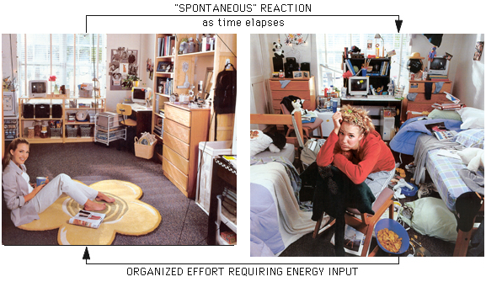
Chapter 17
17.x Bonus chapter: 4th Law of Thermodynamics?

Slide 2
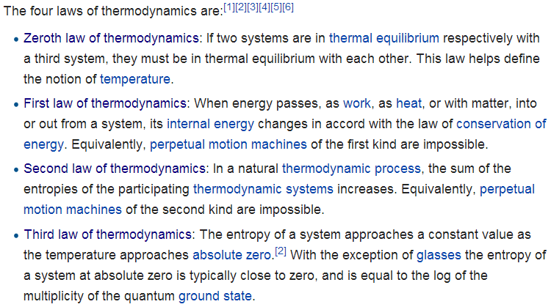
Laws of Thermodynamics
http://en.wikipedia.org/wiki/Laws_of_thermodynamics
Chapter 6
Chapter 17
Fourth law of thermodynamics: Emergent complexity?

Slide 3
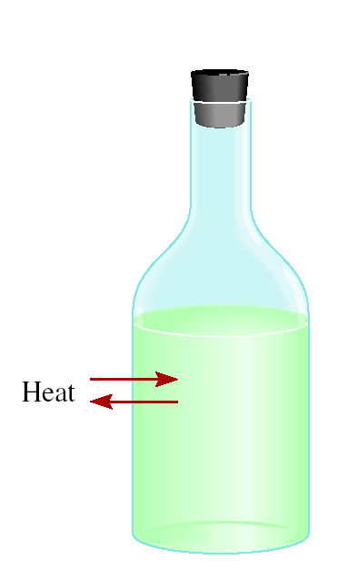
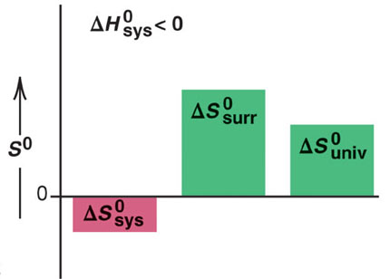
2nd Law of Thermodynamics
The entropy of the universe increases in a spontaneous process.
ΔS_{univ} = ΔS_{sys} + ΔS_{surr}
surrounding
Spontaneous process:
ΔS_{univ} > 0
system
If something happens the total entropy of the universe increases.
ΔG = ΔH_{sys} - TΔS_{sys}
exothermic
-ΔH
- ΔS_{sys}
+ΔS_{surr}
The local entropy decreases (the system becomes more organized) at the cost of increasing entropy to the surrounding environment.
system becomes more ordered

Slide 4
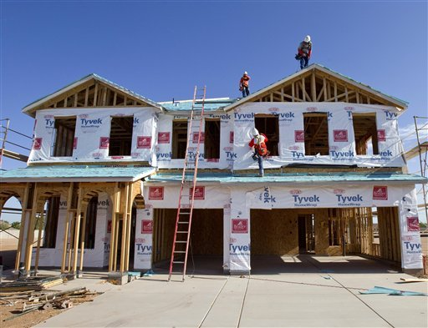
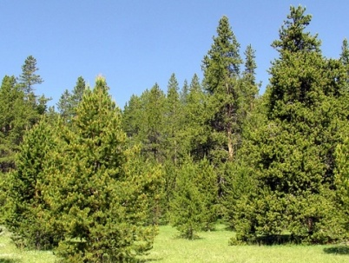
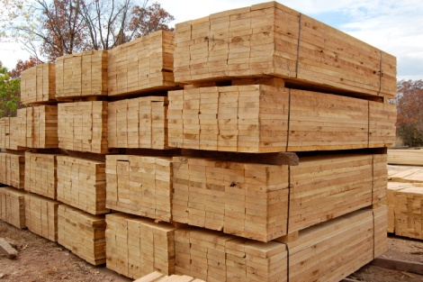
2nd Law of Thermodynamics
The entropy of the universe increases in a spontaneous process.
ΔS_{univ} = ΔS_{sys} + ΔS_{surr}
surrounding
Spontaneous process:
ΔS_{univ} > 0
system
Building a House
ΔS_{sys}
ΔS_{surr}
Surrounding
Burning fuel for transportation, machining, tools, paint manufacturing…
2 C₈H₁₈(l) + 25 O₂ (g) 16 CO₂ (g) + 18 H₂O (l)
Tree to lumber.
System

Slide 5
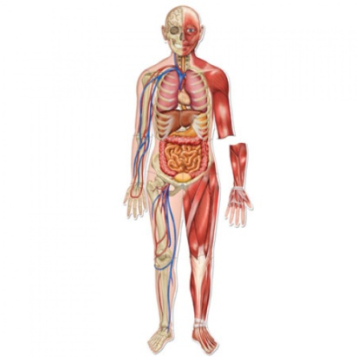
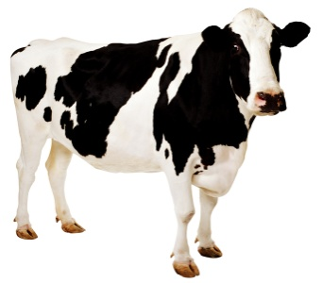
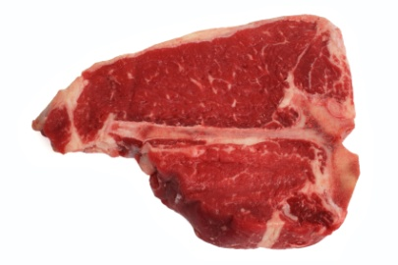
2nd Law of Thermodynamics
The entropy of the universe increases in a spontaneous process.
ΔS_{univ} = ΔS_{sys} + ΔS_{surr}
surrounding
Spontaneous process:
ΔS_{univ} > 0
system
Evolution/Life
ΔS_{sys}
ΔS_{surr}
Surrounding
Digestion and respiration.
2 C₆H₁₂O₆ (aq) + 6O₂ (g) 6CO₂ (g) + 6H₂O (l)
Eating an animal.
System

Slide 6
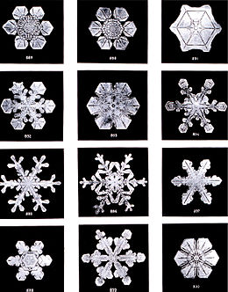
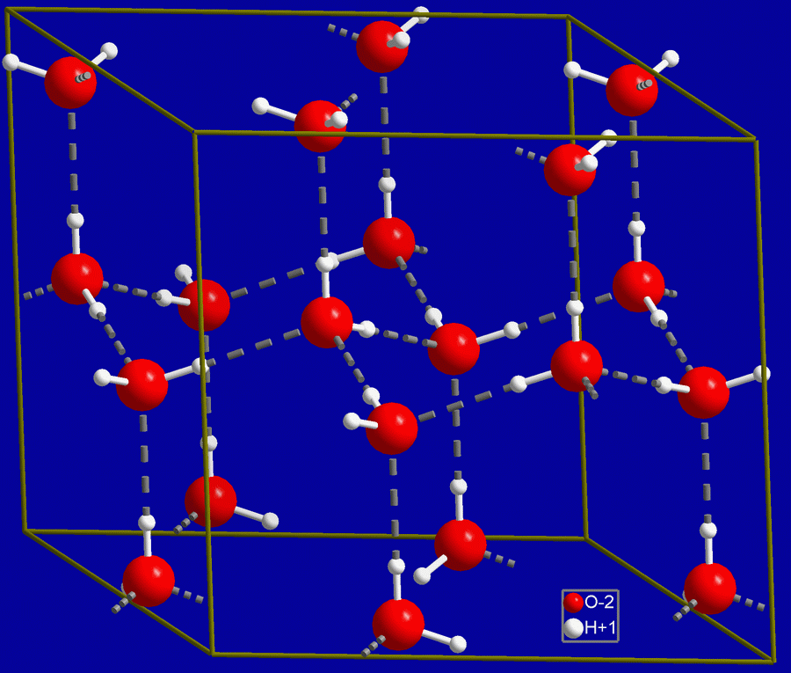
Emergent Complexity
−ΔS_{sys}
= increased order = increased “complexity”
Emergence is a process whereby larger entities, patterns, and regularities arise through interactions among smaller or simpler entities that themselves do not exhibit such properties.
Snowflakes
Emergence
Emergence

Slide 7
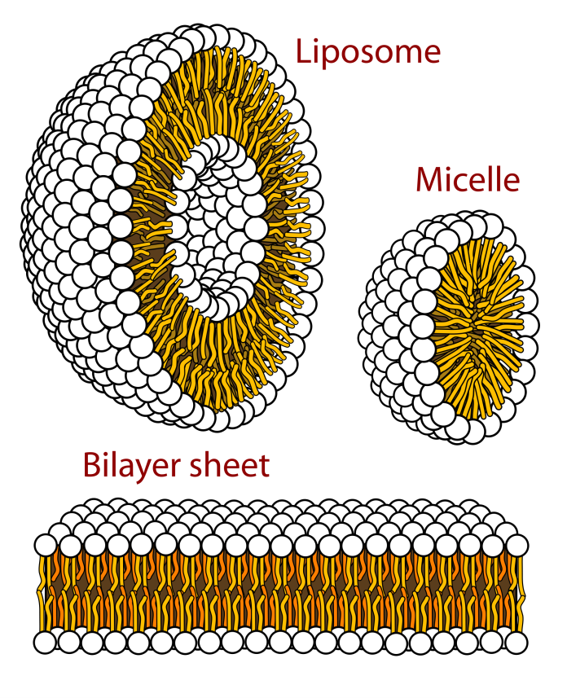
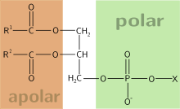
Emergent Complexity
ΔS_{sys}
= increased order = increased “complexity”
Emergence is a process whereby larger entities, patterns, and regularities arise through interactions among smaller or simpler entities that themselves do not exhibit such properties.
Amphiphilic Molecules
Emergence

Slide 8

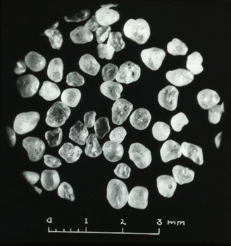
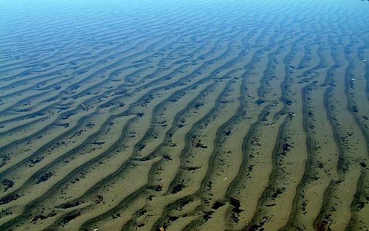
Emergent Complexity
ΔS_{sys}
= increased order = increased “complexity”
Emergence is a process whereby larger entities, patterns, and regularities arise through interactions among smaller or simpler entities that themselves do not exhibit such properties.
Sand Ripples
wind
and/or
water
+
Emergence

Slide 9
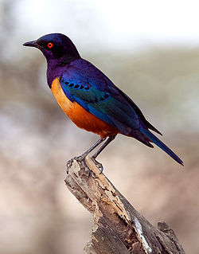
Emergent Complexity
ΔS_{sys}
= increased order = increased “complexity”
Emergence is a process whereby larger entities, patterns, and regularities arise through interactions among smaller or simpler entities that themselves do not exhibit such properties.
Flock of Birds/Murmuration
Emergence
https://www.youtube.com/watch?v=iRNqhi2ka9k
Starling

Slide 10
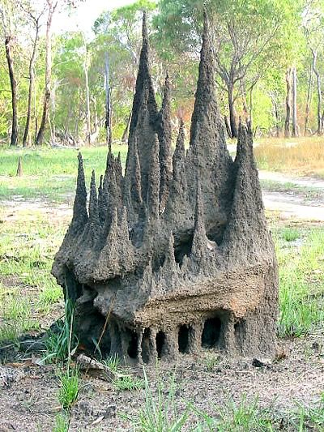
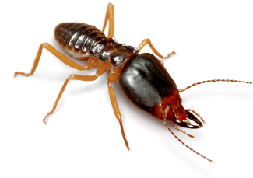
Emergent Complexity
ΔS_{sys}
= increased order = increased “complexity”
Emergence is a process whereby larger entities, patterns, and regularities arise through interactions among smaller or simpler entities that themselves do not exhibit such properties.
Ant/Termite Colony
Emergence

Slide 11
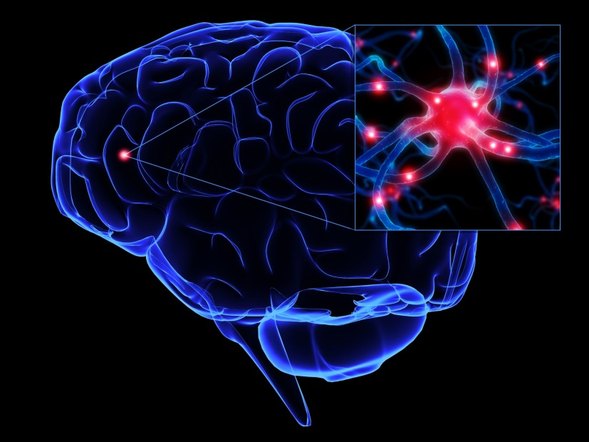
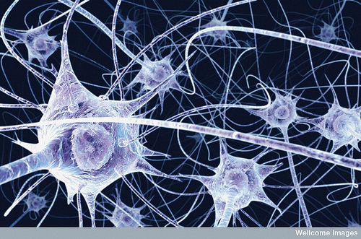
Emergent Complexity
ΔS_{sys}
= increased order = increased “complexity”
Emergence is a process whereby larger entities, patterns, and regularities arise through interactions among smaller or simpler entities that themselves do not exhibit such properties.
Neurons to Thought
Emergence
Consciousness/Self-awareness

Slide 12

Emergent Complexity
ΔS_{sys}
= increased order = increased “complexity”
Emergence is a process whereby larger entities, patterns, and regularities arise through interactions among smaller or simpler entities that themselves do not exhibit such properties.
Traffic
Emergence
https://www.youtube.com/watch?v=UEIn8GJIg0E

Slide 13

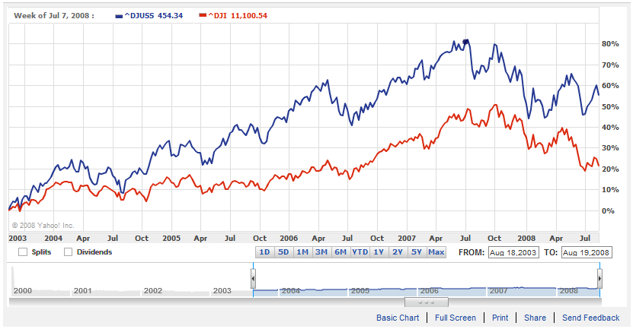

Emergent Complexity
ΔS_{sys}
= increased order = increased “complexity”
Emergence is a process whereby larger entities, patterns, and regularities arise through interactions among smaller or simpler entities that themselves do not exhibit such properties.
Stock Market
Emergence
Invisible hand-
“Every individual necessarily labours to render the annual revenue of the society as great as he can…and he is in this, as in many other cases, led by an invisible hand to promote an end which was no part of his intention.” (Adam Smith 1776)

Slide 14
Emergent Complexity
ΔS_{sys}
= increased order = increased “complexity”
Emergence is a process whereby larger entities, patterns, and regularities arise through interactions among smaller or simpler entities that themselves do not exhibit such properties.
Commonality required features to all of these emergent phenomena:
the number of units/elements/parts
interaction between the units
energy into the system
Is there an equation to describe emergent phenomena?
Bottom up vs. top down approach.

Slide 15

Simple to Complex
The Sierpinski triangle may be constructed from an equilateral triangle by repeated removal of triangular subsets:
Start with an equilateral triangle.
Subdivide it into four smaller congruent equilateral triangles and remove the central one.
Repeat step 2 with each of the remaining smaller triangles
Simple set of rules (interactions) = highly complex structure

Slide 16
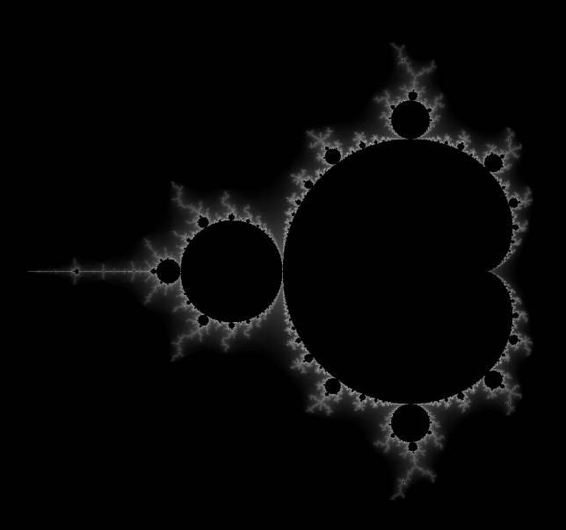
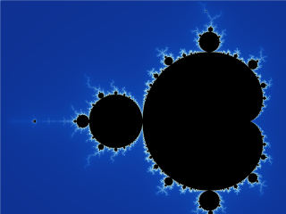
Simple to Complex
The Mandelbrot set :
f_{c}(z) = z² + C
Input C (a complex number) and a z into the function
Take the result and replace z
Repeat
Map in a Cartesian coordinate
Simple set of rules (interactions) = infinitely complex structure

Slide 17


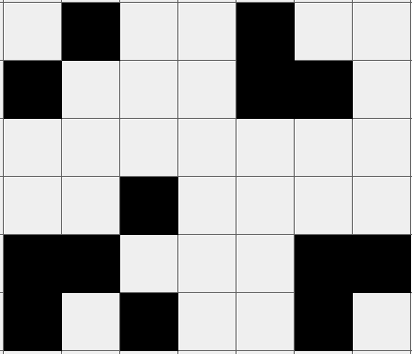
Simple to Complex
Cellular automaton consists of a regular grid of cells, each in one of a finite number of states, such as on and off, that obeys a simple set of rules of that govern the interaction of cells.
Conway’s Game of Life:
= “live” cell
The rules:
Any live cell with fewer than two live neighbours dies, as if caused by under-population.
Any live cell with two or three live neighbours lives on to the next generation.
Any live cell with more than three live neighbours dies, as if by overcrowding.
Any dead cell with exactly three live neighbours becomes a live cell, as if by reproduction.
= “dead” cell
(1)
(2)
(3)
(4)

Slide 18

Simple to Complex
Conway’s Game of Life:
= “live” cell
= “dead” cell
(1)
(2)
1 unit of time
(3)
(4)
The rules:
Any live cell with fewer than two live neighbours dies, as if caused by under-population.
Any live cell with two or three live neighbours lives on to the next generation.
Any live cell with more than three live neighbours dies, as if by overcrowding.
Any dead cell with exactly three live neighbours becomes a live cell, as if by reproduction.

Slide 19
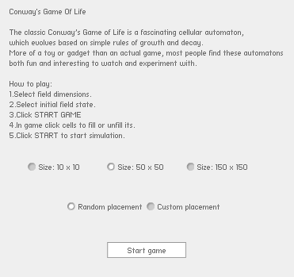
Conway’s Game of Life
http://www.kongregate.com/games/shaman4d/conways-game-of-life

Slide 20

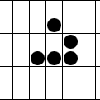

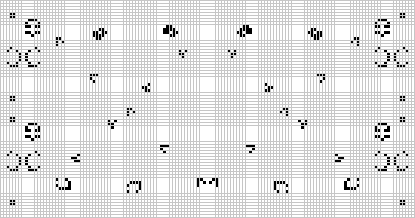
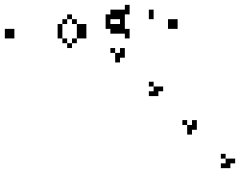
Conway’s Creatures
Blinker
Glider
Spaceship
Gosper glider gun
Doublex

Slide 21
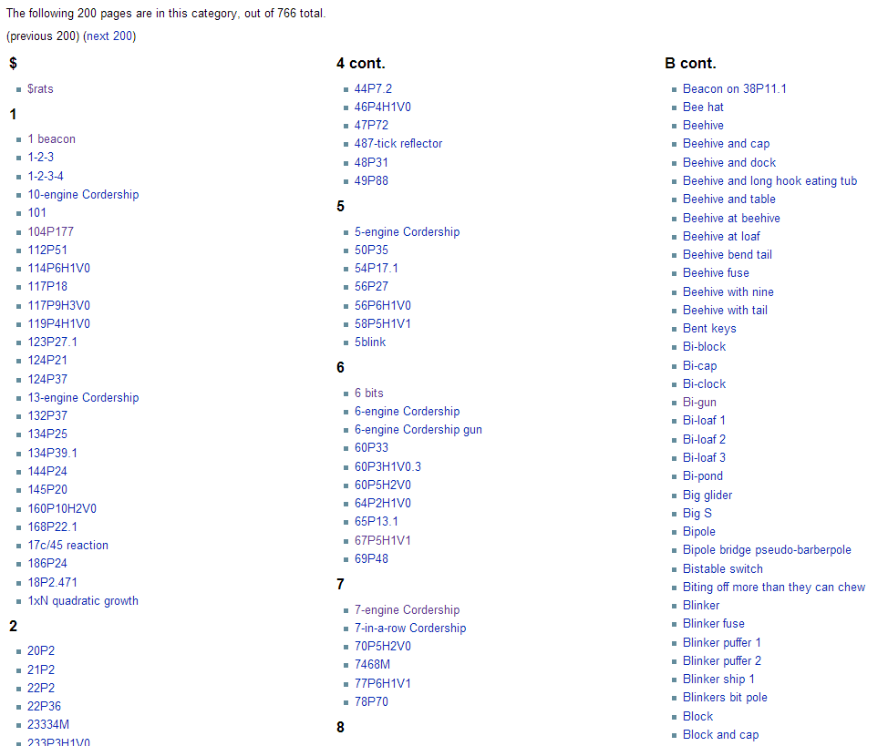
Conway’s Creatures
http://www.conwaylife.com/wiki/Category:Patterns

Slide 22
Conway’s Creatures
https://www.youtube.com/watch?v=C2vgICfQawE
https://www.youtube.com/watch?v=xP5-iIeKXE8
http://lmgtfy.com/?q=conway%27s+game+of+life

Slide 23
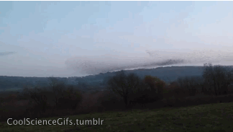
Simple to Complex
Spontaneous complexity can arise but…
Does it have to?

Slide 24
Laws of Thermodynamics
Tells us what can and cannot happen.
Zeroth Law of Thermodynamics
If two systems are in thermal equilibrium respectively with a third system, they must be in thermal equilibrium with each other.
First Law of Thermodynamics
Energy can be converted from one form to another but energy cannot be created or destroyed.
Second Law of Thermodynamics
The entropy of the universe always increases in a spontaneous process and remains unchanged in an equilibrium process.
Third Law of Thermodynamics
The entropy of a pure crystalline substance at absolute zero is 0.
Fourth Law of Thermodynamics(?)
Complex structures will arise when x conditions are met.

Slide 25
4th Law of Thermodynamics
Commonality required features to all emergent phenomena:
the number of units/elements/parts
the degree/strength of the interaction between the units
how energy into the system effects the units
the changes in energy input
(n)
(IPF)
(H or U or E or q)
(dE)
a numerical descriptor for complexity (S or maybe H-unit?)
n
S
E
H-unit
An equation to describe all emergent complexity.
The fourth law of thermodynamics.
=
IPF
dE
Goal: Make a prediction like: given n units in x volume with a degree of interaction y and energy input z then q amount of complexity/order must arise.

Slide 26
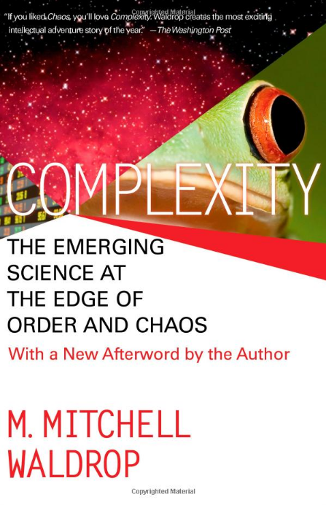




Emergent Complexity
Mathematics, physics, chemistry, biology, economics, psychology, information theory, anthropology ….
Someone please solve this before I die!
Step 1- Understand the phenomenon.
Step 2- Control the phenomenon.

Slide 27
Chapter 17
17.x Bonus chapter: 4th Law of Thermodynamics?

Slide 28
Mission Accomplished
43 class periods
40 lectures
  ~2000 minutes of class
  ~1100 ppt slides
  ~400 pages of the text book
8 Homework assignments
  102 Homework questions
1 Extra credit assignment
3 tests
1 final (pending)
  Climbed ~2700 steps (~200 calories)

Slide 29

Why were we here?
To fulfill your degree requirements
To increase scientific literacy
To prepare you for your future
Chemistry is fun/interesting/important
A means of evaluating you
(?)

Slide 30


Who is this guy?

